Slide 1


Slide 2
Learning Outcome
Apply the cost categorization concepts in preparation of cost sheet of the companies.

Slide 3
Meaning
Cost sheet is a statement of cost. In other words, when costing information are set out in the form of a statement, it is called cost sheet. For determination of total cost of production a statement showing the various elements of cost is prepared.
This statement is called as a ‘statement of cost’ or ‘cost sheet’.

Slide 4

Calculation of Materials Consumed:
Materials Consumed = (Opening stock of raw materials + Purchase of raw material + carriage / freight inward) - (closing stock of raw material).
Calculation of Prime Cost:
Prime Cost = Materials consumed + direct wages + direct expenses.
Calculation of Factory cost:
Factory Cost = Prime cost + sum of all factory overheads.
Calculation of Cost of Production
Cost of Production = Factory cost + office and administration overheads.
Calculation of Cost of Sales or Total Cost
Total Cost = Cost of production + selling and distribution overheads.
Calculation of Total Sales
Total Sales = Total cost + net profit.

Slide 5

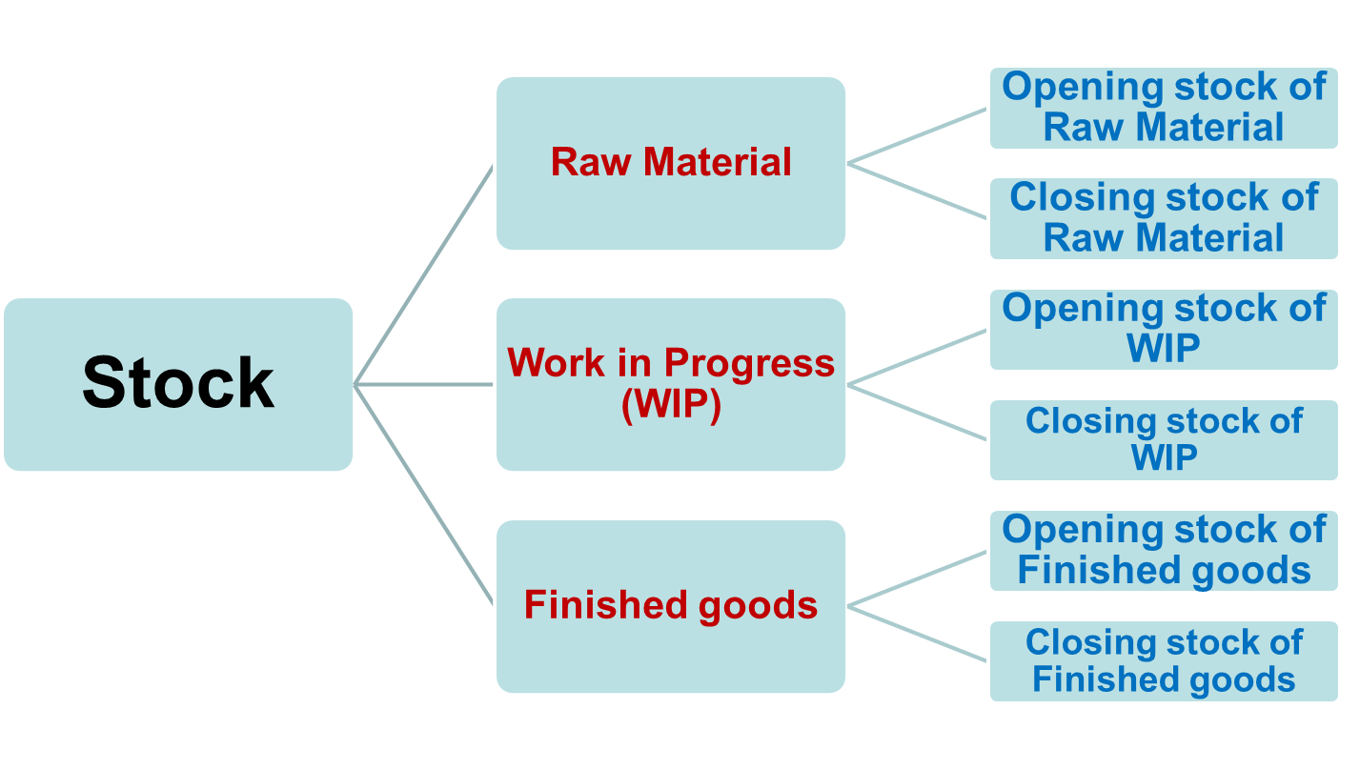

Slide 6

A) Sale of Material Scrap = Adjustment under material consumed
B) Sale of Factory Scrap = Adjustment under Factory cost

Slide 7

Particulars | Amount | Amount
Opening Stock of Raw Material Add: Purchase of Raw materials Add: Purchase Expenses Less: Closing stock of Raw Materials Less;- Sale of Material Scrap (if any) Raw Materials Consumed ADD: Direct Wages (Labour) ADD:Direct Expenses (Chargeable expenses) | *** *** *** *** *** _________ *** *** ***
Prime cost (1) |  | ***
Add :- Factory Over Heads: Factory Rent Factory Power Indirect Material Indirect Wages Supervisor Salary Drawing Office Salary Factory Insurance Factory Asset Depreciation Less:- Sale of Factory Scrap ( If any) | *** *** *** *** *** *** *** ***
Add: Opening Stock of WIP Less: Closing Stock of WIP | *** ***
Works cost/ Factory Cost (2) |  | ***

Slide 8

Add:- Office and Administration Overheads:- Office Rent Asset Depreciation General Charges Audit Fees Bank Charges Counting house Salary Other Office Expenses | *** *** *** *** *** *** ***
Cost of Production (3) |  | ***
Add: Opening stock of Finished Goods Less: Closing stock of Finished Goods | *** ***
Cost of Goods Sold (4) |  | ***
Add:- Selling and Distribution OH:- Sales man Commission Sales man salary Traveling Expenses Advertisement Delivery man expenses Bad Debts | *** *** *** *** *** ***
Cost of Sales /Total Cost (5) |  | ***
Add: Profit |  | ***
Sales |  | ***

Slide 9
Ques.
Calculate Prime cost from the following information:-
Opening stock of raw material = Rs. 12,500
Purchased raw material = Rs. 75,000
Expenses incurred on raw material = Rs. 5,000
Closing stock of raw material = Rs. 22,500
Wages Rs. 47,600
Direct expenses Rs. 23,400

Slide 10
Ques.
Calculate works cost or factory cost from the following details:-
Raw material consumed = Rs 50,000
Direct wages = Rs20, 000
Direct expenses = Rs 10,000
Factory expenses 80% of direct wages
Opening stock of work in progress = Rs 15,000
Closing stock of work in progress = Rs 21,000

Slide 11
Calculate the prime cost, factory cost, cost of production, cost of sales and profit form the following particulars:
Direct Material | 2,08,000
Direct wages | 1,45,000
Direct expense | 50,000
Lighting: Factory | 3,000
Office | 1,000
Repair of Plant, Machinery and tools | 8,600
Rent, rates, taxes (Factory) | 3,000
Rent, rates, taxes (office) | 1,000
Advertisement expense | 10,000
Salesman salary | 3,700
Depreciation written off on machinery, plant and tools | 9,100
Depreciation written off on office furniture | 600
Director's fees | 6,000
Gas and water charges (factory) | 1,000
Gas and water charges (office) | 300
Office stationery | 1,000
Office salaries | 9,600
Sundry office expense | 3,000
Total sales | 6,00,000

Slide 12
From the following particulars, prepare cost sheet for the year ended 31.12.2018
Rs
Stock of finished goods (1.1.2018) 6000
Stock of raw materials (1.1.2018) 60,000
Work in progress (1.1.2018) 15,000
Purchase of raw material 4,55,000
Factory rent, taxes 7,250
Other production expenses 43,000
Stock of finished goods (31.12.2018) 15,000
Wages 1,75,000
Work manager salary 20,000
Factory employees salary 70,000
Power expenses (factory) 9,500
General expenses 32,500
Sales for the year 9,60,000
Stock of raw material (31.12.2018) 50,000
Work in progress (31.12.2018) 10,000

Slide 13
Ques.
Mr. Zia furnishes the following data related to the manufacture of a standard product during the month of August 2018
Raw material consumed - Rs 15,000
Direct labour - Rs 5,000
Direct expenses - Rs. 4000
Machine hours worked - 900 hrs.
Machine hour rate - Rs 5
Administration overheads - 20% of works cost
Selling overheads - Rs 0.50 per unit
Unit produced - 17,100
Unit sold - 16,000 @ Rs 4 per unit
You are required to prepare a cost sheet from the above showing:-
The cost per unit, Cost per unit sold and profit for the period
Notes:
Hint: Closing stock of finished goods= Units produced – Units sold
= 17,100 – 16000
=1100 units
Value of closing stock of finished goods= 1600 x Rs. 2 per unit (cost of production p.u.)
= 3200 Rs.

